Slide 1
Data Base System Week 3rd Topics
Schemas, Instances, and Database State
ANSI SPARC Architecture
Mapping
Data Independence
CENTRALIZED AND CLIENT/SERVER ARCHITECTURES FOR DBMSS
CLASSIFICATION OF DATABASE MANAGEMENT SYSTEMS

Slide 2
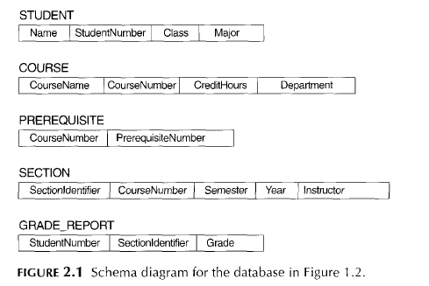
Data Base System Week 3rd Topics
Database Schema
The structure which contains description of objects created by the user e.g. views, tables etc
Which is specified during database design and is not expected to change frequently
schema diagram
the diagram displays the structure of each record type but not the actual instances of records
schema construct
We call each object in the schema-such as STUDENT or COURSE

Slide 3
Data Base System Week 3rd Topics
The permanent structure of DB is called intension of DB or database schema
The data stored at a given time is called extension of DB or DB instance
The extension of DB is performed after the intension of DB has been finalized
The extension of DB is performed according to the rules defined in the intension
Initial State
We get the initial state of the database when the database is first populated or loaded with the initial data
current state
every time an update operation is applied to the database, we get another database state. At any point in time, the database has a current state
valid state
a state that satisfies the structure and constraints specified in the schema
The schema is sometimes called the intension, and a database state an extension of the schema.
schema evolution
For example, we may decide that another data item needs to be stored for each record in a file, such as adding the DateOfBirth to the STUDENT schema
Types
External Schema
Conceptual Schema
Internal Schema

Slide 4
Data Base System Week 3rd Topics
ANSI SPARC Architecture
The Standard Planning and Requirements Committee of American National Standards Institute committee on Computers and Information Processing -1975
The basis for modern database architecture i.e. DB can be viewed at 3 levels depicted by three models \ schemas
Objectives of Three-Level Architecture
All users should be able to access same data.
A user’s view is immune to changes made in other views.
Users should not need to know physical database storage details.
DBA should be able to change database storage structures without affecting the users’ views.
Internal structure of database should be unaffected by changes to physical aspects of storage.
DBA should be able to change conceptual structure of database without affecting all users

Slide 5
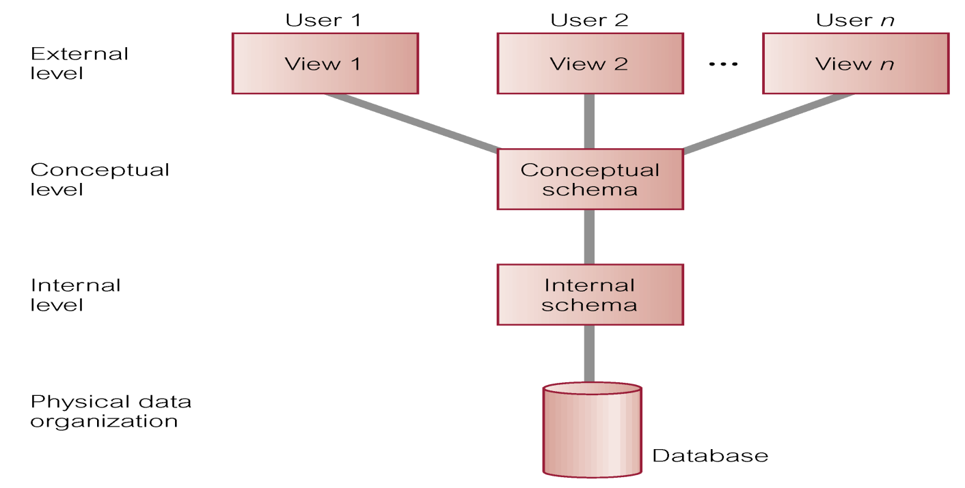
Data Base System Week 3rd Topics
Three-Level Schema

Slide 6
Data Base System Week 3rd Topics
ANSI SPARC Architecture
1. External Level
Users’ view of the database.
Describes that part of database that is relevant to a particular user.
Also Called User View/ Human Interface
User will be either application programmer or end user
All user’s will see only a part of DB not whole DB
User’s views are combined, defined and formatted and forwarded to
conceptual level for processing
2. Conceptual Level
Also called Global or Community view of the database.
Describes what data is stored in database and relationships among the data
This Level contains logical structure of DB as seen by DBA
No description of storage and space consideration e.g. no bytes occupied
Constraints on data e.g. name will not be null
Semantic info about data e.g. admission before birth
Security and integrity e.g. what users are authorized for DB

Slide 7
Data Base System Week 3rd Topics
ANSI SPARC Architecture
3. Internal Level
Responsible to store data in the database.
Describes how the data is stored in DB by DBMS on computers
File organization, access methods, record placement, data compression and encryption all techniques are provided by internal level
defines the methods by which the records are linked i.e. relationship among entities
The internal schema uses a physical data model and describes the complete details of data storage and access paths for the database
Physical Data Model
Last Level of three level architecture
Description of physical devices used for grouping of devices
Addressing techniques manage by OS under the direction of DBMS

Slide 8
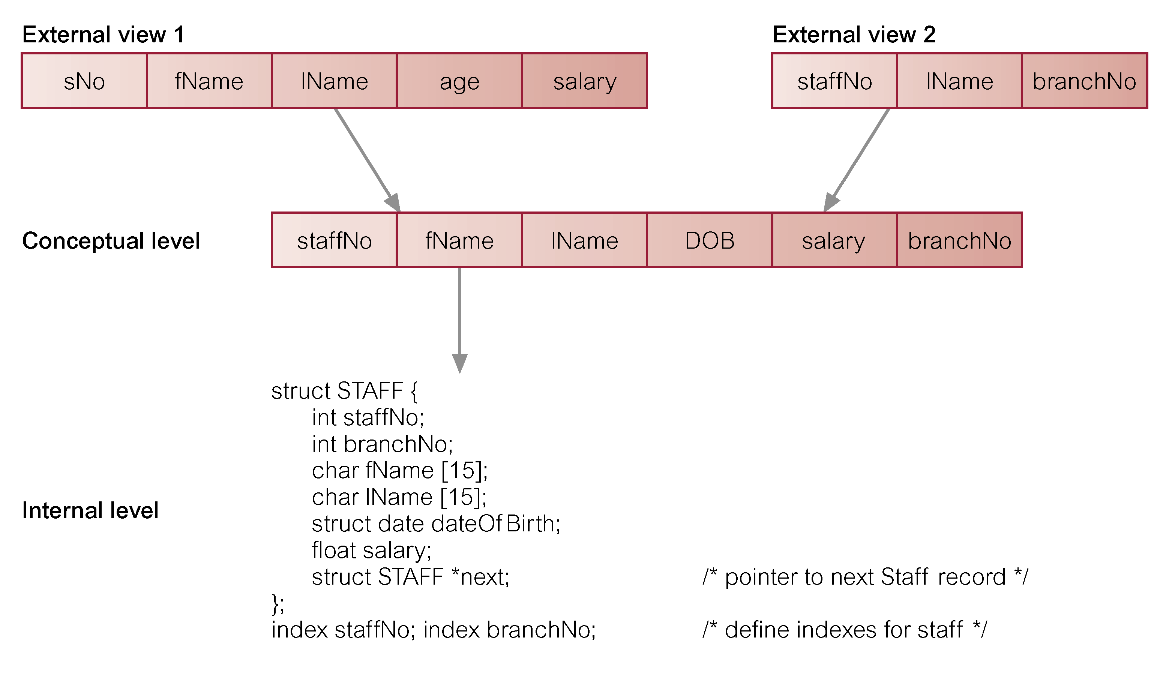
Data Base System Week 3rd Topics
ANSI SPARC Architecture

Slide 9
Data Base System Week 3rd Topics
Mapping
The process of performing request and retrieving results between levels are called mapping
These mappings may be time-consuming, so some DBMSs-especially those that are meant to support small databases-do not support external views
Types
External / Conceptual Mapping
Conceptual / Internal Mapping
Data Independence
The separation of data and application program is called Data Independence
It is an important feature of DBMS and advantage of three level architecture
Accomplished when the schema is changed at some level the schema at the next higher level remains unchanged
Enable the user to change the structure of DB without changing application program

Slide 10
Data Base System Week 3rd Topics
Types of Data Independence
Logical Data Independence
Enables the user to change the conceptual level without having to change the external level or application program i.e. to expand the database
Adding or removal of entities
Adding a file to DB
Adding new field to the file
Changing the type of a field etc
to change constraints
Physical Data Independence
Enables the user to change the internal level without having to change the conceptual level or application program or external schemas
Changing the organization or storage structure
Using different storage devices
by creating additional access structures-to improve the performance of retrieval or update

Slide 11
Data Base System Week 3rd Topics
CENTRALIZED AND CLIENT/SERVER
ARCHITECTURES FOR DBMSS
Centralized DBMSS Architecture
database systems used these computers in the same way as they had used display terminals, which were connected to the central computer via various types of communications networks
so that the DBMS itself was still a centralized DBMS in which all the DBMS functionality, application program execution, and user interface processing were carried out on one machine
Basic Client/Server Architectures
The client/server architecture was developed to deal with computing environments in
which a large number of PCs, workstations, file servers, printers, database servers, Web
servers, and other equipment are connected via a network
e.g. file server that maintains the files of the client
printer server by being connected to various printers; thereafter, all print requests by the clients are forwarded to this machine
The client machines provide the user with the appropriate interfaces to utilize these servers, as well as with local processing power to run local applications
A server is a machine that can provide services to the client machines, such as file access, printing, archiving, or database access.

Slide 12
Data Base System Week 3rd Topics
Two-Tier Client/Server Architectures for DBMSS
In such a client/server architecture, the user interface programs and application programs can run on the client side.
When DBMS access is required, the program establishes a connection to the DBMS (which is on the server side)
once the connection is created, the client program can communicate with the DBMS
A standard called Open Database Connectivity (ODBC) provides an application Programming interface (API), which allows client-side programs to call the DBMS,
client program can actually connect to several RDBMSs and send query and transaction requests using the ODBC API, (Start menu → control panel → Administrative tools →ODBC (32 /64))
which are then processed at the server sites. Any query results are sent back to the client program, which can process or display the results as needed
In such a client/server architecture, the server has been called a data server, because it provides data in disk pages to the client.

Slide 13
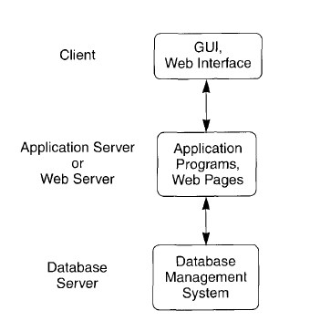
Data Base System Week 3rd Topics
Three-Tier Client/Server Architectures for Web Applications
Many Web applications use an architecture called the three-tier architecture
Which adds an intermediate layer between the client and the database server,
This intermediate layer or middle tier is sometimes called the application server and sometimes the Web server, depending on the application

Slide 14
Data Base System Week 3rd Topics
This server plays an intermediary role by storing business rules (procedures or constraints) that are used to access data from the database server.
It can also improve database security by checking a client's credentials before forwarding a request to the database server
Clients contain GUI interfaces and some additional application-specific business rules.
The intermediate server accepts requests from the client, processes the request and sends database commands to the database server, and then acts as a conduct for passing (partially) processed data from the database server to the clients, where it may be processed further and filtered to be presented to users in GUI format.
CLASSIFICATION OF DATABASE
MANAGEMENT SYSTEMS
data model
relational data model (main)
object data model (not widespread)
hierarchical and network data models (older)
number of users
Single-user systems support only one user at a time and are mostly used with
personal computers.
Multiuser systems, which include the majority of DBMSs, support multiple users concurrently.

Slide 15
Data Base System Week 3rd Topics
CLASSIFICATION OF DATABASE
MANAGEMENT SYSTEMS
number of sites
A DBMS is centralized if the data is stored at a single computer site
A distributed DBMS (DDBMS) can have the actual database and DBMS software distributed over many sites, connected by a computer network
Homogeneous DDBMSs use the same DBMS software at multiple sites
A recent trend is to develop software to access several autonomous preexisting databases stored under heterogeneous DBMSs.
cost of the DBMS
DBMS packages cost between $10,000 and $100,000
types of access path
One well-known family of DBMSs is based on inverted file structures
Finally
special purpose.: when performance is a primary consideration, a special-purpose DBMS can be designed and built for a specific application
Many airline reservations and telephone directory systems developed in the past are special purpose DBMS

